Slide 1


Wi-Fi HaLow 802.11ah characterization under Swiss / EU regulations
Francesco Murande
&
Tony Raffoul
Ecole Polytechnique Fédérale de Lausanne
5th June 2024

Slide 2



Francesco Murande Escobar
MS EE, specialization IoT | EPFL
BS EE | Politecnico di Torino
francesco.murandeescobar@epfl.ch
Tony Raffoul
BS Microengineering | EPFL
tony.raffoul@epfl.ch
Academic Advisor: Prof. Andreas Burg – TCL Lab
Supervisor: Herman Hüni – Ganstrich Energie AG

Slide 3

Motivation
Increasing interest in 802.11ah.
Availability of new modules on the market.
Limited focus on Swiss/European regulatory constraints.
Understanding technology limitations.
Testing and validating expectations.
GOAL: Comprehensive characterization of Wi-Fi HaLow capabilities in compliance with CH/EU regulatory requirements.

Slide 4
OUTLINE
Overview
Regulations
Market Availability
Characterization Setup
Results & Interpretations
Summary

Slide 5
OUTLINE
Overview
Regulations
Market Availability
Characterization Setup
Results & Interpretations
Summary

Slide 6
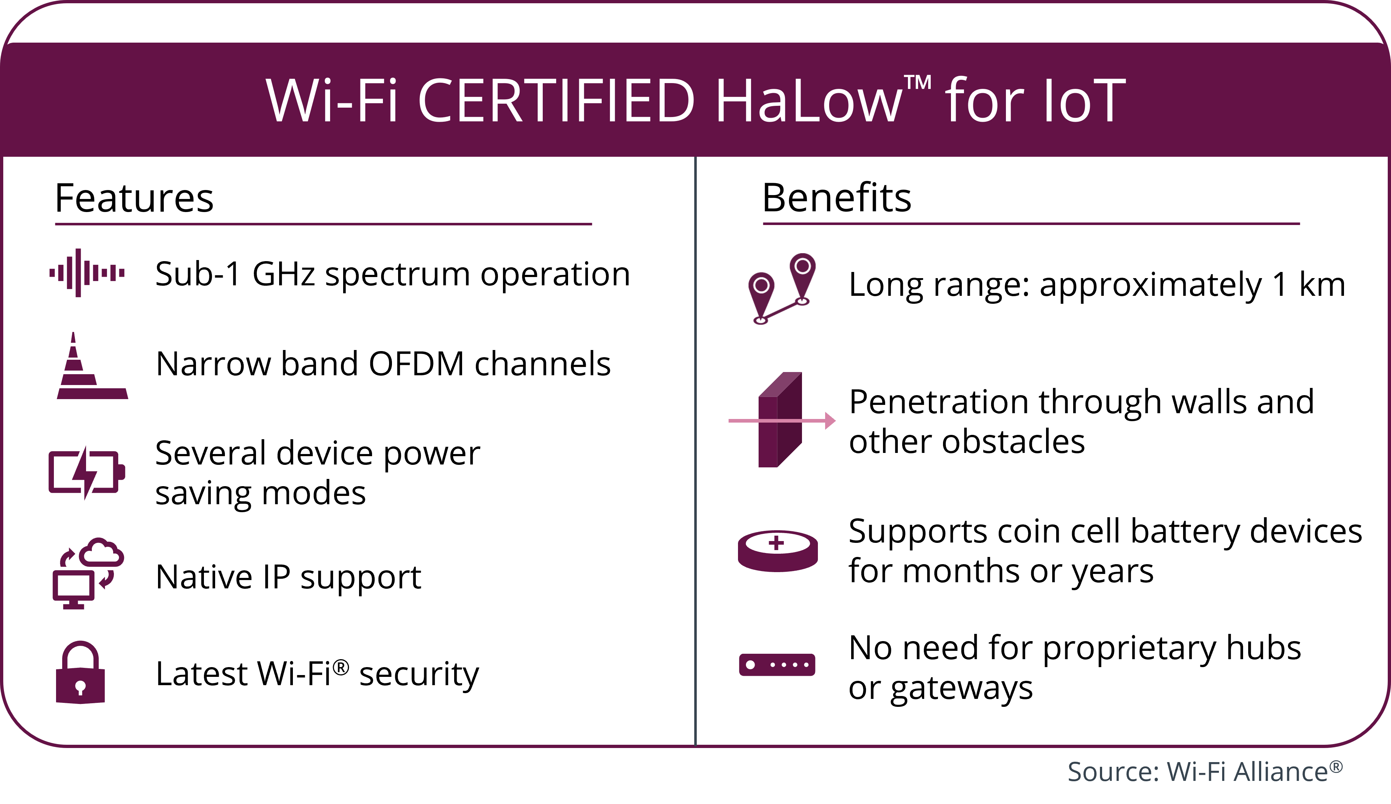
WiFi HaLow
Wi-Fi HaLow (IEEE 802.11ah) published in 2017.
Operates in sub-1 GHz band.
Enables medium to long-range low-power communication.
Innovative power-saving modes for IoT needs.
Supports standard Wi-Fi security.
Up to 8191 devices per Access Point.
Overview
Regulations
Market Availability
Characterization Setup
Results & Interpretation
Summary

Slide 7
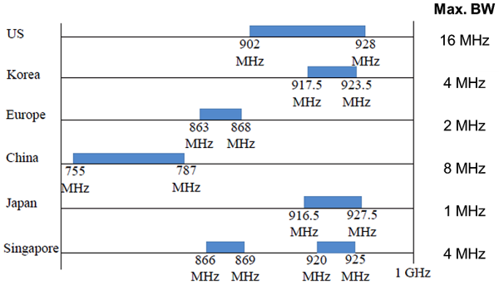
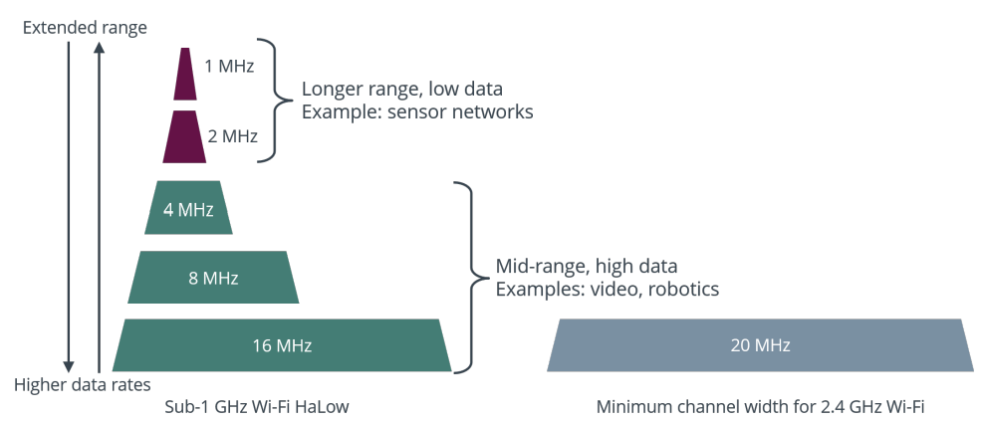
Operation in Sub-1GHz Frequency Band
Less congested operation band than 2.4GHz and 5GHz.
Lower Free Space Path Loss thanks to its lower frequency.
Allocated Frequency: 863-868 MHz.
Channels bandwidth:
CH/EU: 1, 2 [MHz]
US: 1, 2, 4, 8 ,16 [MHz]
*Source: https://www.eenewseurope.com/en/ieee-802-11ah-wi-fi-below-1-ghz/
WiFi HaLow operation bands
*CH/EU allowed bands
*Source: WHITE PAPER: Wi-Fi CERTIFIED HaLow™ Technology Overview
WiFi Halow channel bandwidths
Overview
Regulations
Market Availability
Characterization Setup
Results & Interpretation
Summary

Slide 8
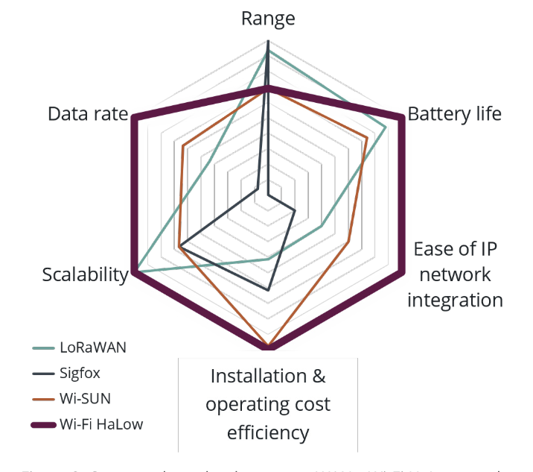
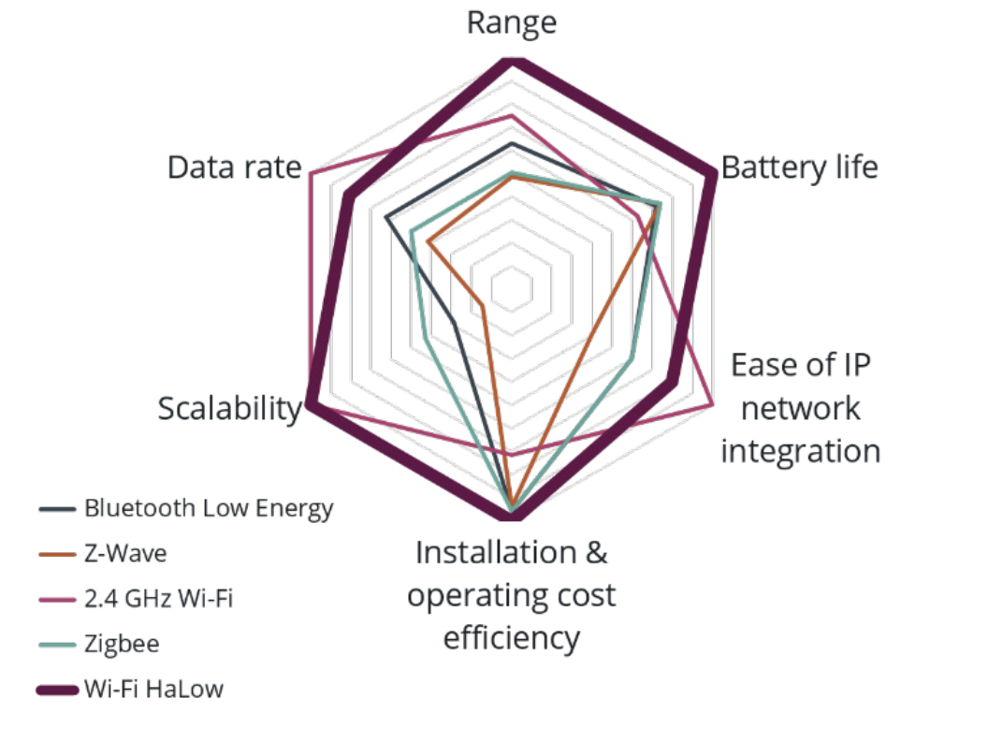
Technology Comparison
Comparison of HaLow to LPWAN technologies
Comparison of HaLow to PAN technologies
*Source: WiFi Alliance WiFi HaLow white paper
WiFi HaLow Workshop Bern
Higher Data Rate and Battery life than LPWAN IoT
Higher Range and Battery life than PAN
Overview
Regulations
Market Availability
Characterization Setup
Results & Interpretation
Summary

Slide 9
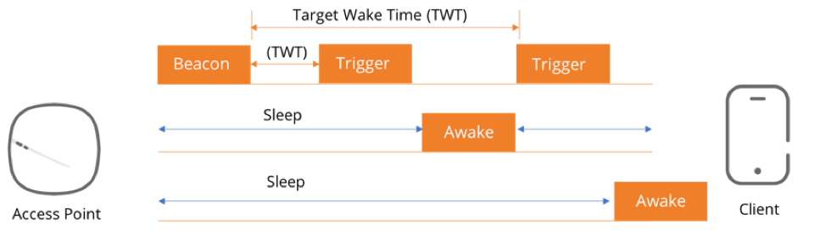
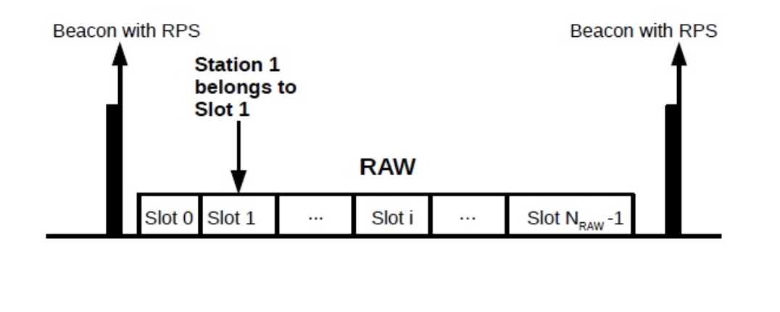
MAC Features
RAW (Restricted Access Window): subset of clients transfer data, while others are forced to sleep.
Not-TIM (Traffic Indication Map) modes: devices do not have to stay awake to actively monitor the beacon frames.
TWT (Target Wake Time): client device enter a very low power sleep state, until the target wake time arrives.
Shorter MAC headers.
AP
*Source: Available at https://blogs.arubanetworks.com/solutions/three-ways-802-11ax-makes-wi-fi-better/
STA1
STA2
Target Wake Time Mechanism
*Source: Soares, S.M.; Carvalho, M.M. "Throughput Analytical Modeling of IEEE 802.11ah Wireless Networks."
Restricted Access Window Mechanism
Overview
Regulations
Market Availability
Characterization Setup
Results & Interpretation
Summary

Slide 10
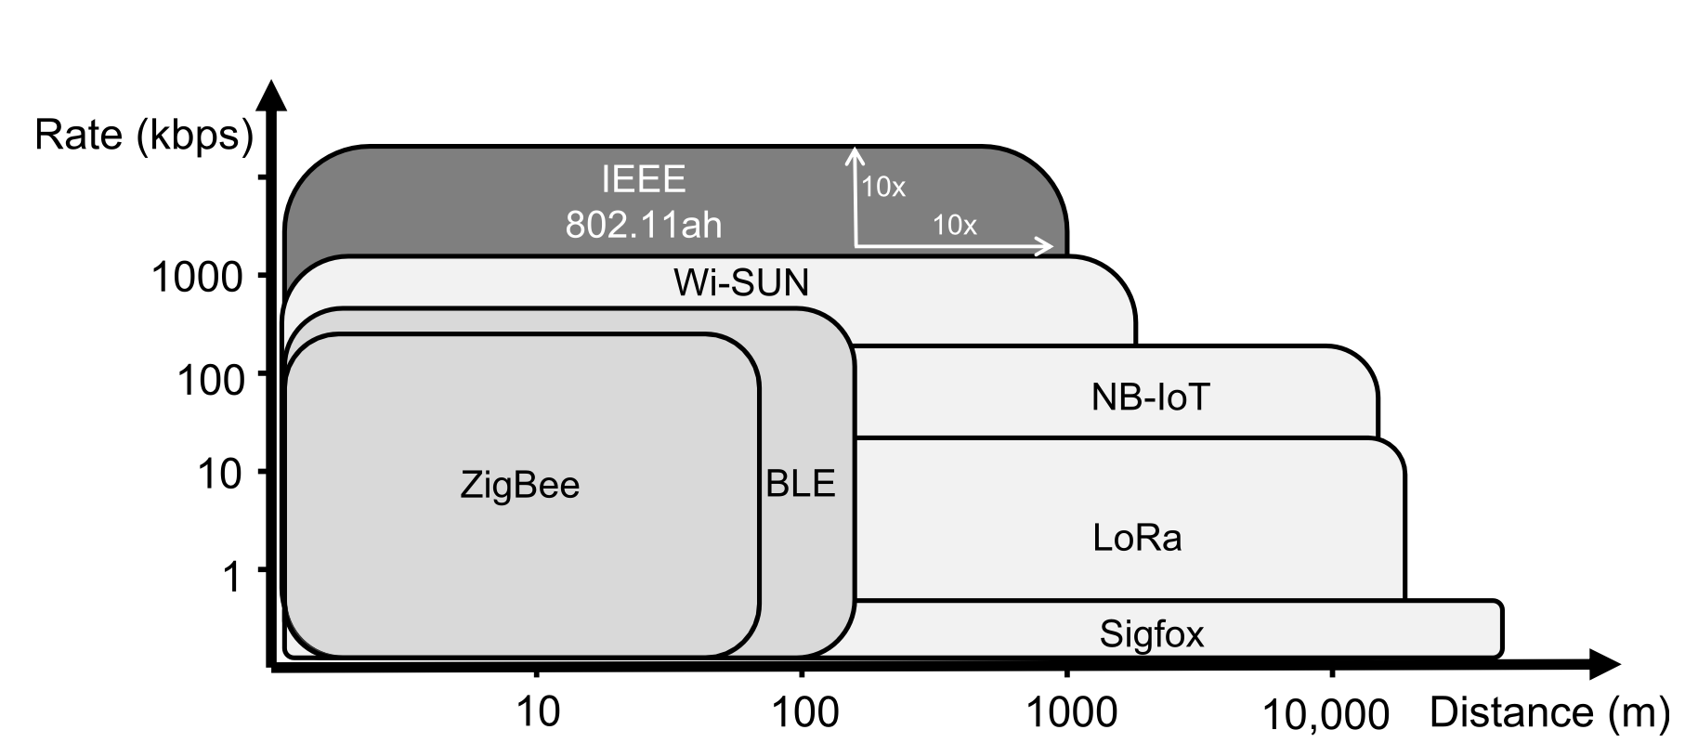
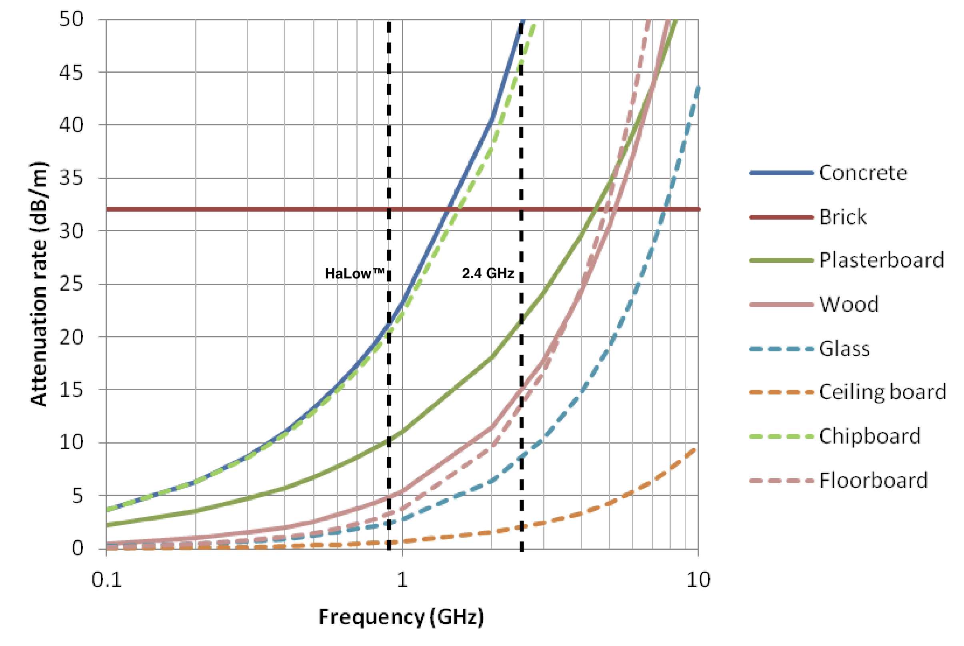
Filling the gap between PAN and LPWAN
*Source: Wi-Fi HaLow for the Internet of Things: An up-to-date survey on IEEE 802.11ah research, Journal of Network and Computer Applications,Volume 182, 2021.
Extended range compared to PAN / LAN.
Higher bitrate than LPWAN.
Good signal penetration through walls and obstacles.
Range-Rate comparison of existing LPWAN technologies
*Source: Richard Rudd et al. “Building Materials and Propagation: Final Report”. In: Ofcom 2604/BMEM/R/3/2.0 (Sept. 2014).
Attenuation rates of building materials.
Overview
Regulations
Market Availability
Characterization Setup
Results & Interpretation
Summary

Slide 11


OUTLINE
Overview
Regulations
Market Availability
Characterization Setup
Results & Interpretations
Summary

Slide 12
Regulations (ECC & BAKOM)
European and Swiss regulations are aligned.
Polite spectrum access:
Listen Before Talk (LBT) + Adaptive Frequency Agility (AFA).
Wider bands : 4MHz is not allowed; unable to do AFA.
Parameter | Values
Frequency band | 863-868 MHz
Transmit power | Max. 25 mW e.r.p | 14dbm
Channel Access | Polite Spectrum Access
Duty cycle max | 2.8% (STA), 10% (AP)
Bandwidth | >600 kHz ≤ 1MHz
Available at:
BAKOM WLAN FACTSHEET
Swiss National Frequency Allocation Planand Specific Assignments
Switzerland and the Principality of Liechtenstein Radio Interface Regulation: RIR1003-11, RIR1003-12
ERC Recommendation 70-03, CEPT, ECC
Overview
Regulations
Market Availability
Characterization Setup
Results & Interpretation
Summary

Slide 13
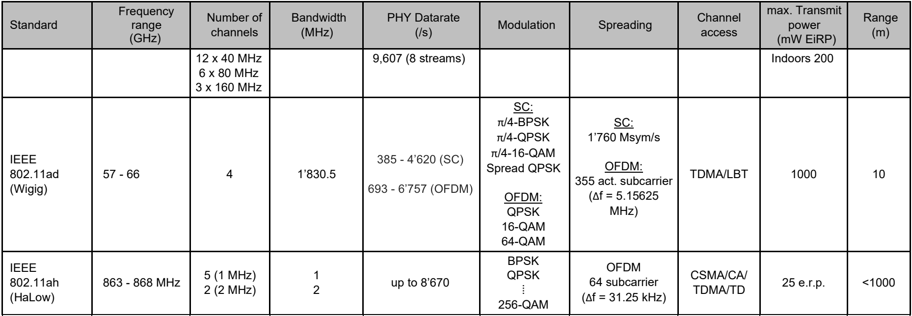
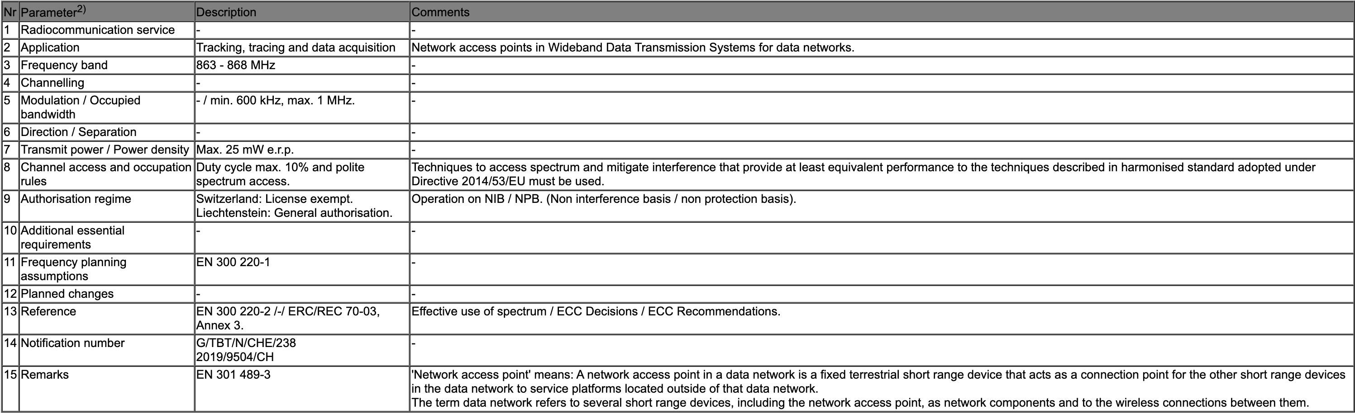
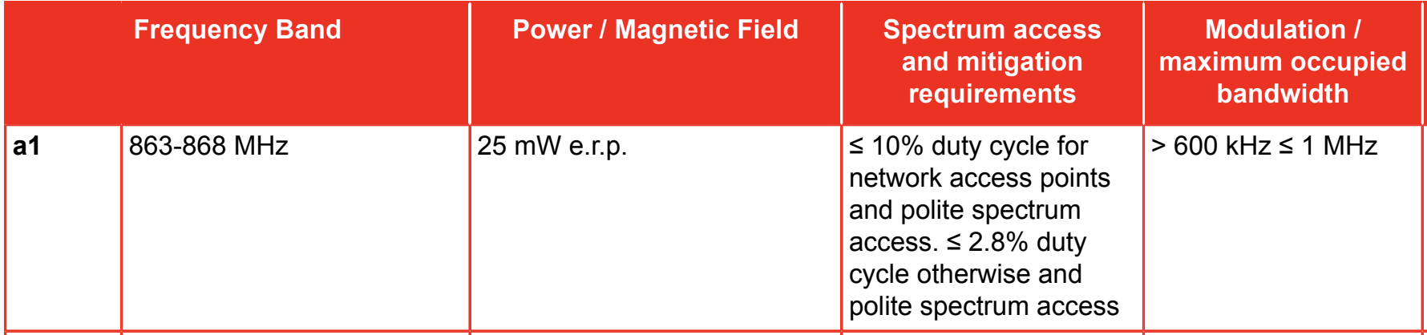
Regulations (ECC & BAKOM)
BAKOM WLAN FACTSHEET
It seems to be a mismatch in channel-bandwidth restrictions:
BAKOM: lists 5 available channels of 1 MHZ and 2 of 2 MHz.
Radio Interface Regulation, CEPT: set an upper bound of 1MHz for the occupied bandwidth.
Switzerland and the Principality of Liechtenstein Radio Interface Regulation: RIR1003-11, RIR1003-12
ERC Recommendation 70-03, CEPT, ECC
Overview
Regulations
Market Availability
Characterization Setup
Results & Interpretation
Summary

Slide 14
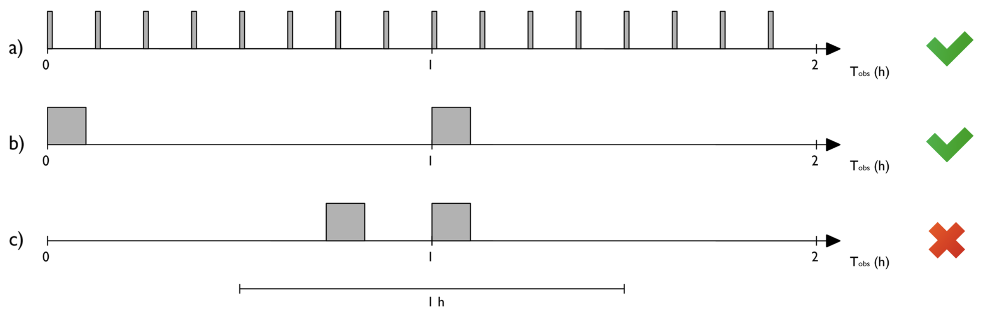
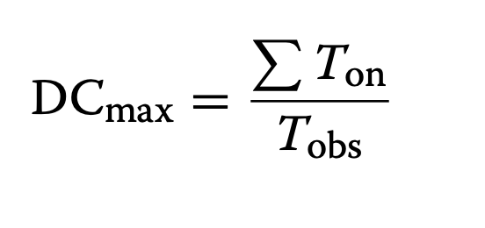
How is the duty cycle measured?
*Source: Impact of EU duty cycle and transmission power limitations for sub-GHz LPWAN SRDs: an overview and future challenges. J Wireless Com Network 2019, 219 (2019).
Transmission time spreading
Default observation period : 1h a. Evenly distributed.
b. Single burst.
c. Not conform to the duty cycle regulations.
Overview
Regulations
Market Availability
Characterization Setup
Results & Interpretation
Summary

Slide 15








OUTLINE
Overview
Regulations
Market Availability
Characterization Setup
Results & Interpretations
Summary

Slide 16
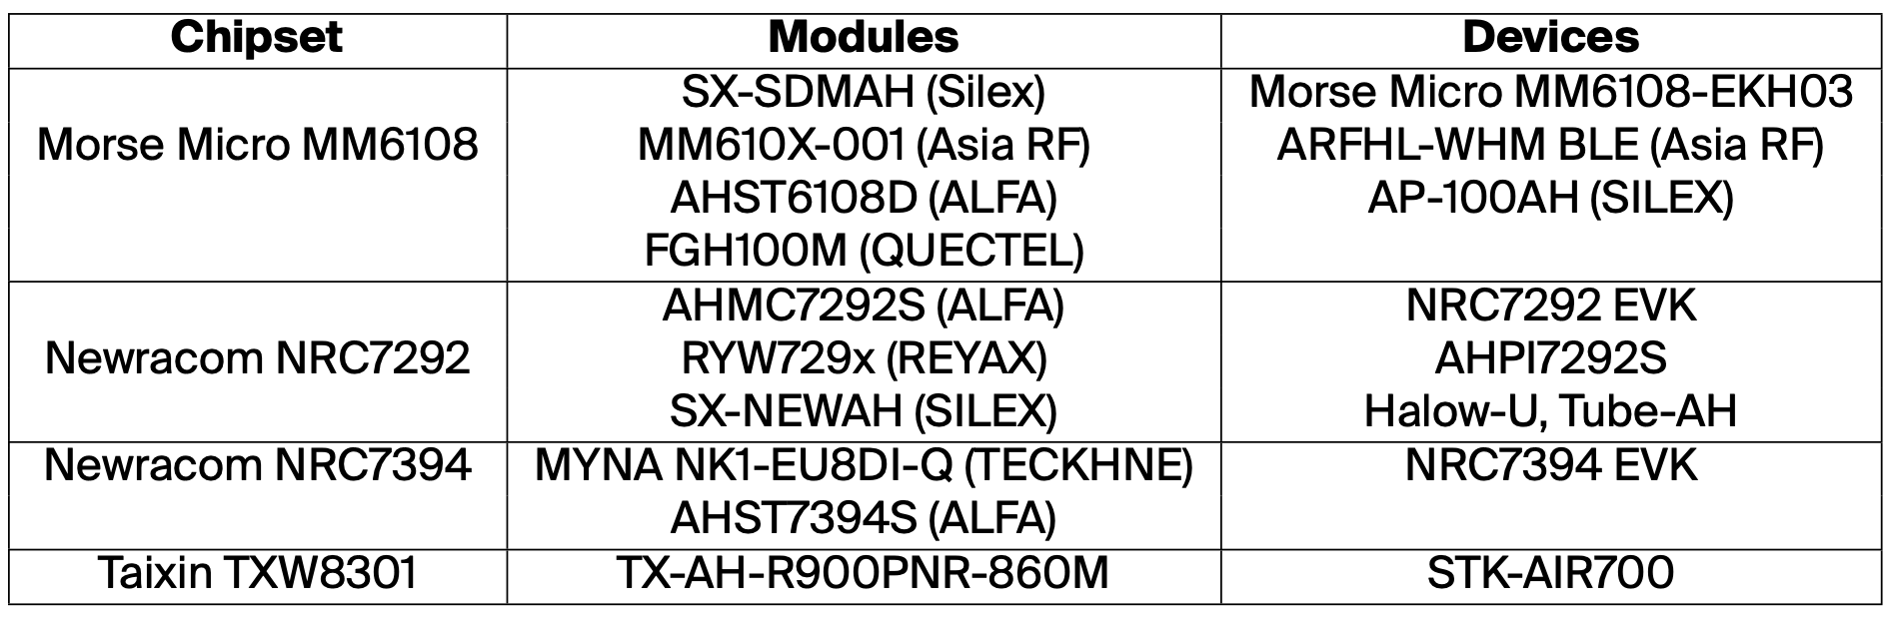
Market Availability
Increasing interest in this technology:
New devices continuously entering the market.
Academic community actively testing and verifying the capabilities of this protocol.
Among the listed modules, only FGH100M (QUECTEL) , MYNA NK1-EU8DI-Q (TECKHNE) and TX-AH-R900PNR-860M seems to have a CE certification.
Overview
Regulations
Market Availability
Characterization Setup
Results & Interpretation
Summary

Slide 17
OUTLINE
Overview
Regulations
Market Availability
Characterization Setup
Results & Interpretations
Summary

Slide 18
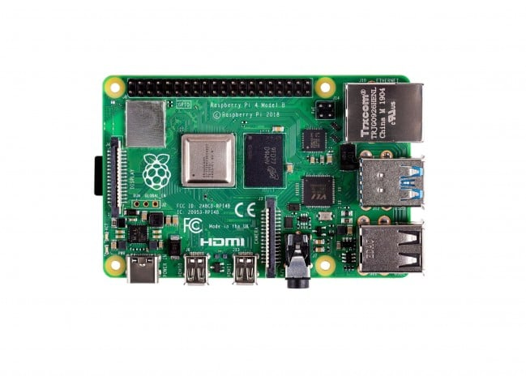
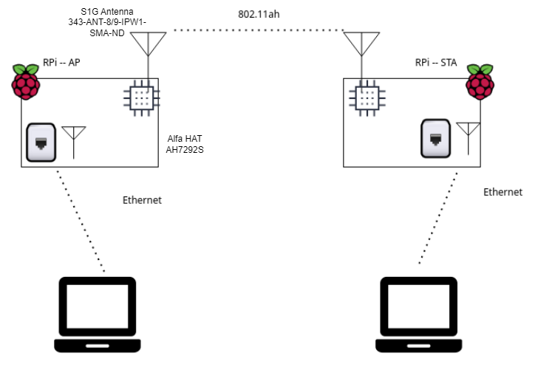
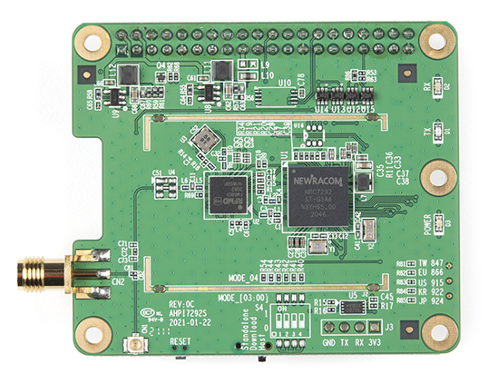
Experimental Setup
Raspberry 4
WiFi HaLow Workshop Bern
NRC7292
ALFA HAT AH7292S
Overview
Regulations
Market Availability
Characterization Setup
Results & Interpretation
Summary

Slide 19
Metrics Collected
Data Rate, through iperf3 test with UDP.
iperf3 –c 192.168.200.1 –u –b 0 –t 30
RSSI and SNR values through CLI_APP provided by vendor NRC.
MCS used by rate control algorithm through CLI app.
Used Software packages:
*CLI app version 2.10
*NRC_SW_1.3.4_2022_04_18
Overview
Regulations
Market Availability
Characterization Setup
Results & Interpretation
Summary

Slide 20
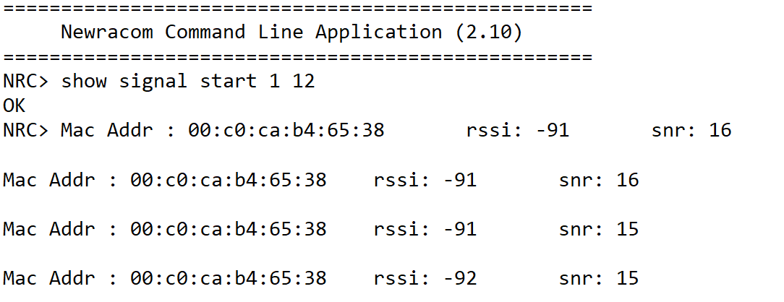
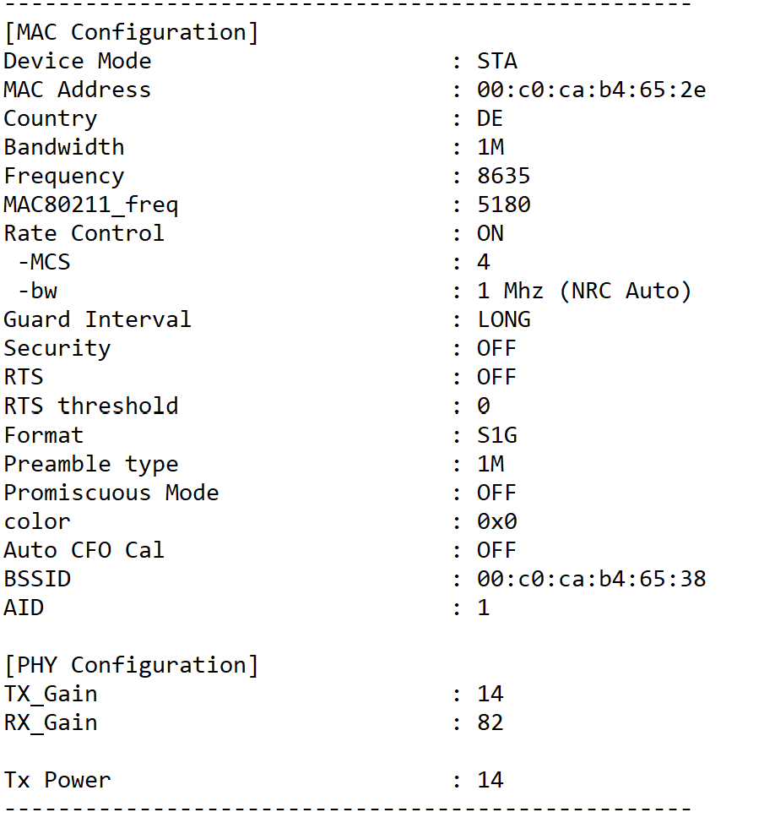
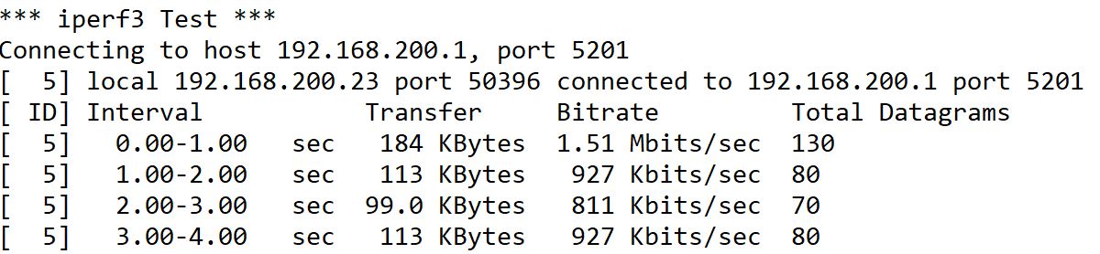
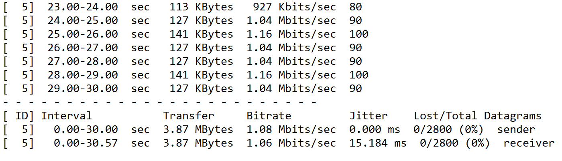
Metrics Collected – Data Example
iperf3 –c 192.168.200.1 –u –b 0 –t 30
Overview
Regulations
Market Availability
Characterization Setup
Results & Interpretation
Summary

Slide 21
Scenarios Considered
Coaxial
Indoor
Outdoor
Controlled environment, limited to no interference.
Sweeping through different transmission power levels with varying attenuation values.
Benchmarking values for device capabilities.
NLoS measurement
Characterizing wall/floor breaking capabilities, robustness of signal .
Tested in 5 different buildings.
LoS measurements
Range test
*236 tests were conducted
Overview
Regulations
Market Availability
Characterization Setup
Results & Interpretation
Summary

Slide 22
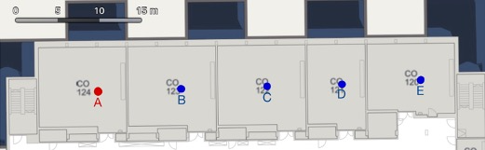
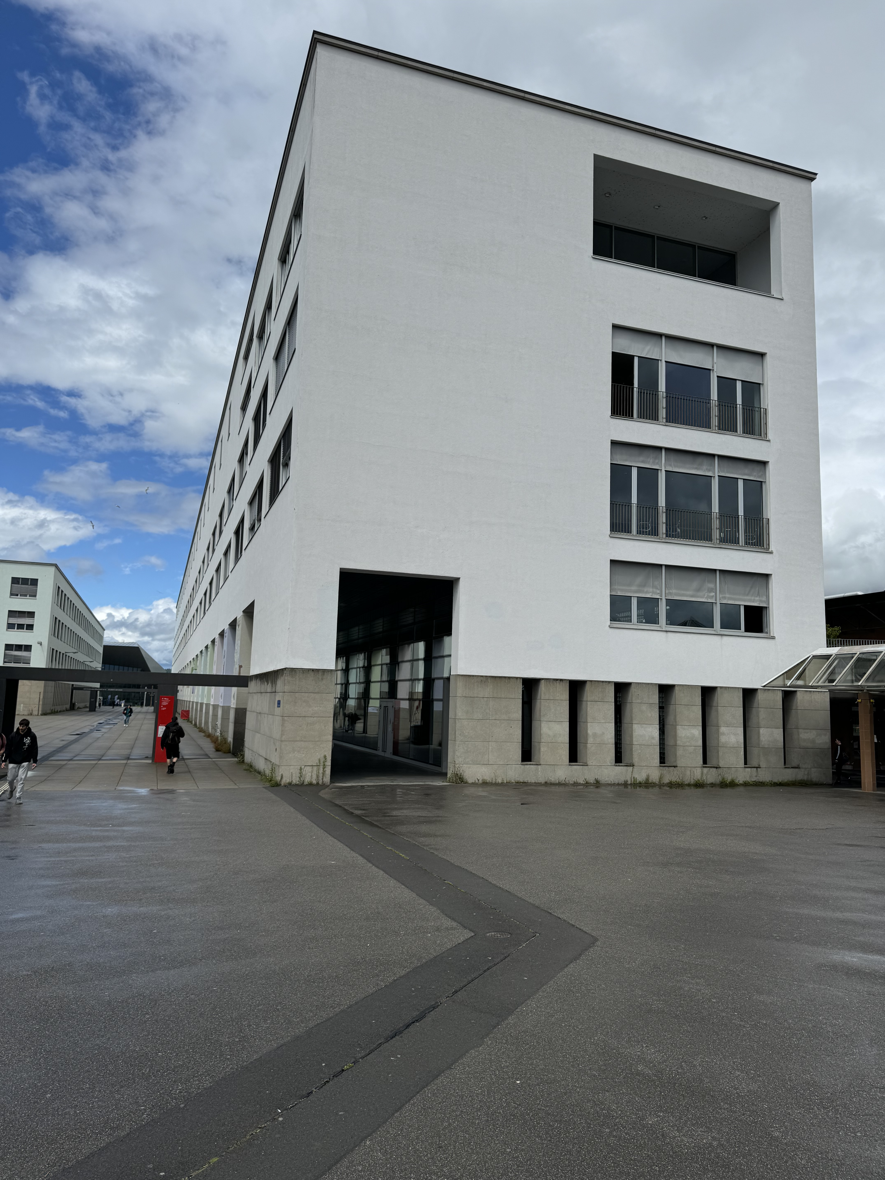
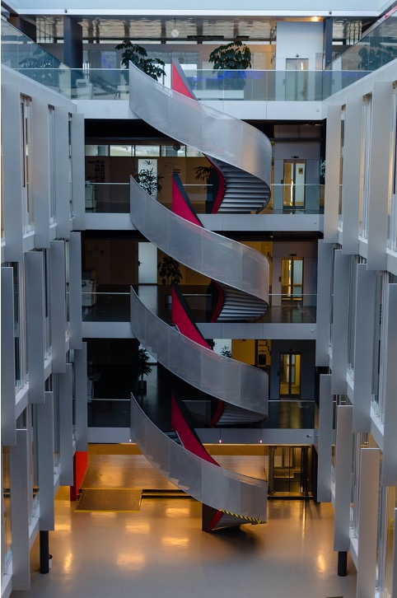


Indoor Scenarios
CO
BM
BC
WiFi HaLow Workshop Bern
Vortex
Atrium
Overview
Regulations
Market Availability
Characterization Setup
Results & Interpretation
Summary

Slide 23
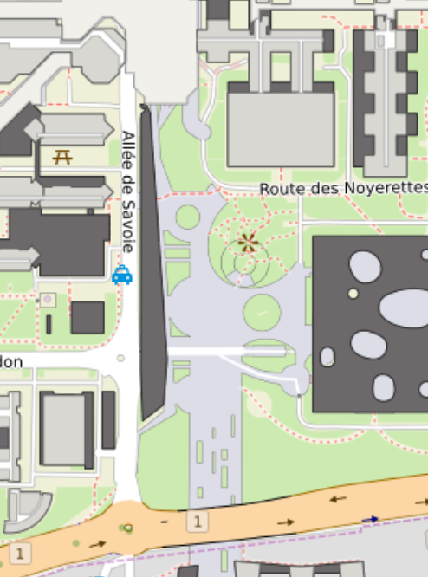
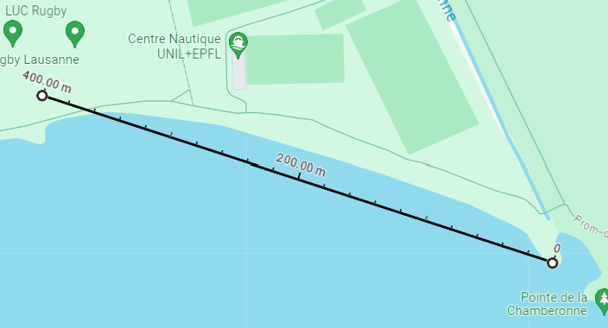


Outdoor Scenarios
EPFL Campus
Lac Léman
400m
300m
WiFi HaLow Workshop Bern
*Source: https://plan.epfl.ch/ , https://www.google.com/maps/@46.5176701,6.5841045,343m/
Overview
Regulations
Market Availability
Characterization Setup
Results & Interpretation
Summary

Slide 24
OUTLINE
Overview
Regulations
Market Availability
Characterization Setup
Results & Interpretations
Summary

Slide 25
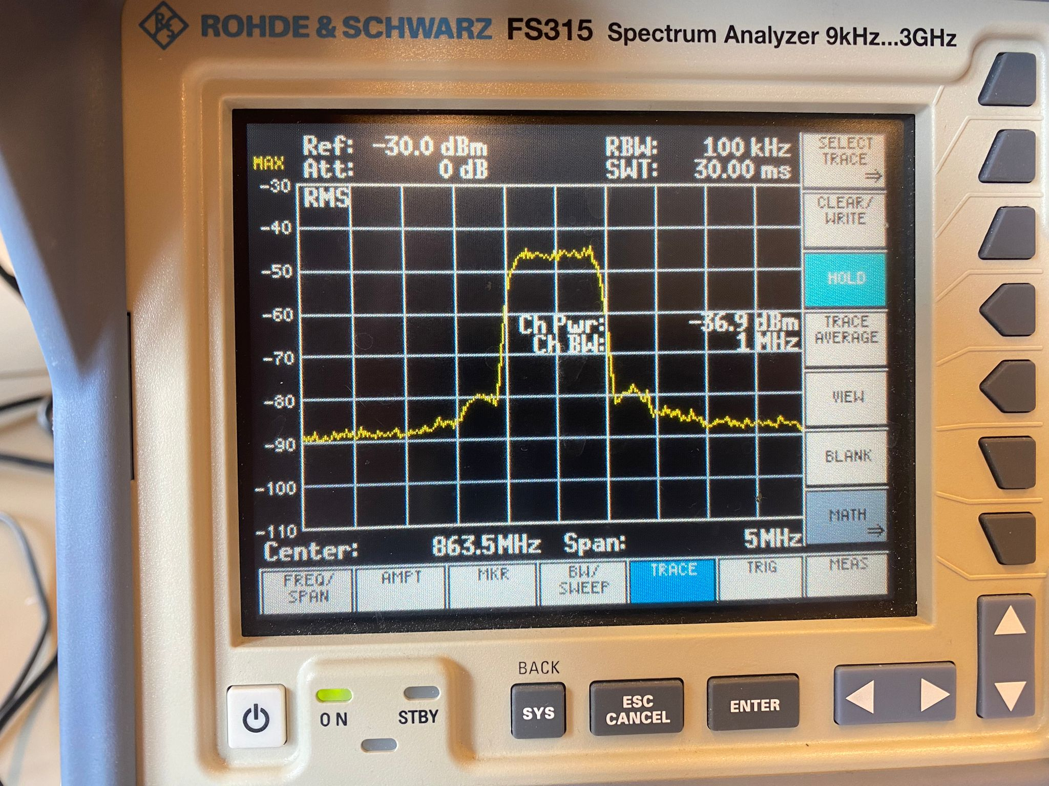
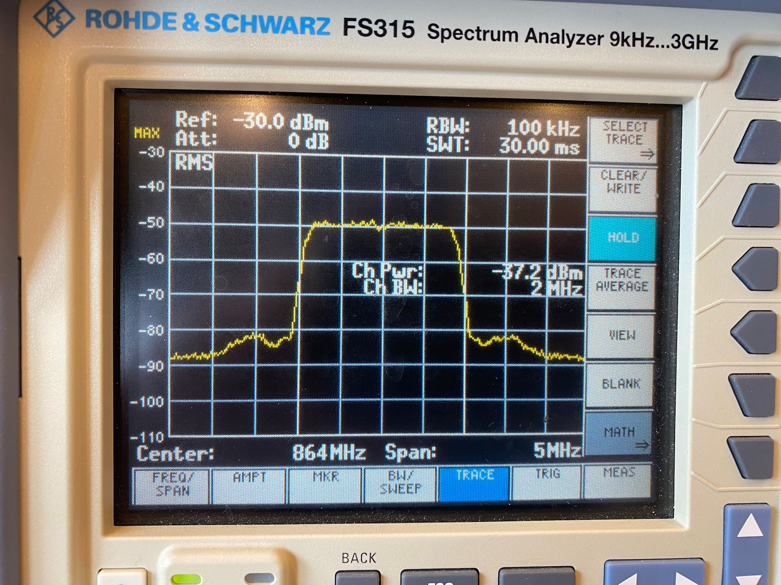
Power & Spectrum Measurements
≈ -37 + 50 = 13dBm
RasPi 4 & Alfa HAT
-50 dB attenuator
Rohde & Schwarz FS315 spectrum analyzer
Coaxial cable
Block Diagram of the measurement environment
2 MHz channel power measurement
1 MHz channel power measurement
Attenuators used to avoid spectrum analyzer saturation.
Considering the 50dB attenuator, max hold peak output power delivered by module is about 13-14 dBm.
Devices respect 25mW – 14dBm power regulations.
Overview
Regulations
Market Availability
Characterization Setup
Results & Interpretation
Summary

Slide 26
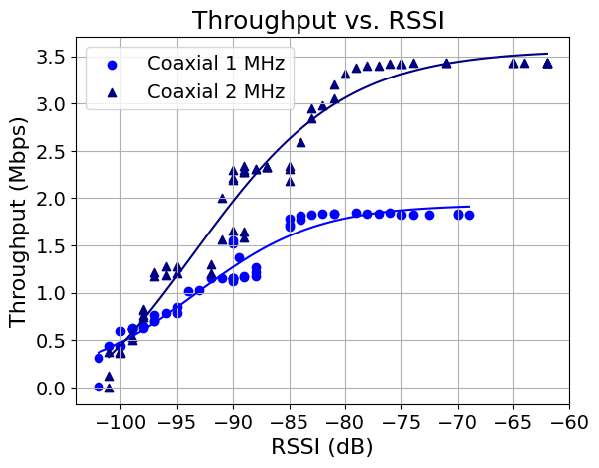
Coaxial Results
Module throughput in controlled setting.
Throughput increases with RSSI values.
Max value for bandwidth:
1MHz : 1.85 Mbps
2MHz : 3.43 Mbps
Overview
Regulations
Market Availability
Characterization Setup
Results & Interpretation
Summary

Slide 27
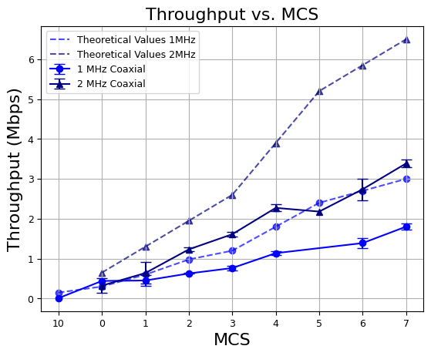
Coaxial Results – Comparing to Theory
Comparing throughput to the standard (Std 802.11-2016) theoretical values
BW | MCS | Modulation | *Theoretical Data Rate (Mbps) | Actual Data Rate (Mbps) | Actual vs. Theoretical Data Rate %
1 | 7 | 64-QAM | 3.00 | 1.85 | 61
2 | 7 | 64-QAM | 6.50 | 3.43 | 52
*IEEE Std 802.11ah-2016 (Amendment to IEEE Std 802.11-2016, as amended by IEEE Std 802.11ai-2016);
Difference between max throughput and UDP throughput could be due to MAC headers, guard intervals…
Other characterization studies yielded similar results**
**Kane, Luke. An Experimental Field Comparison of Wi-Fi HaLow and LoRa for the Smart Grid, Table 5
Overview
Regulations
Market Availability
Characterization Setup
Results & Interpretation
Summary

Slide 28

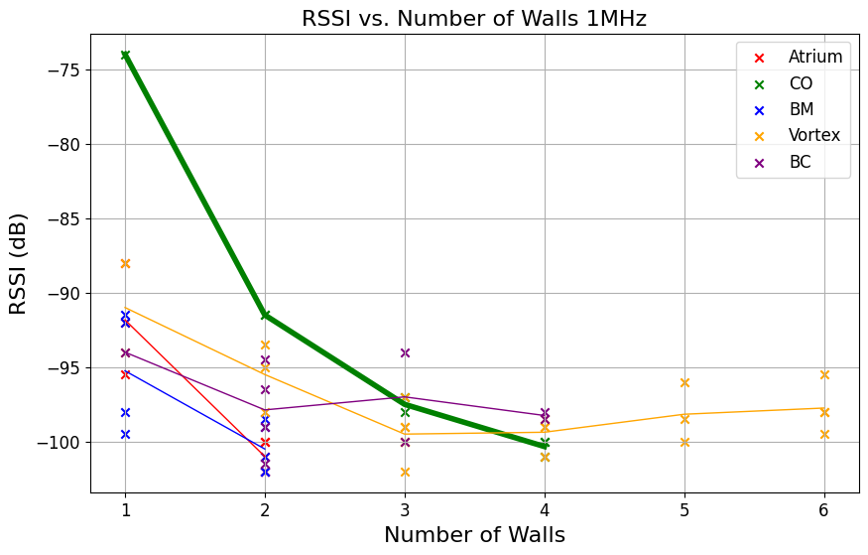
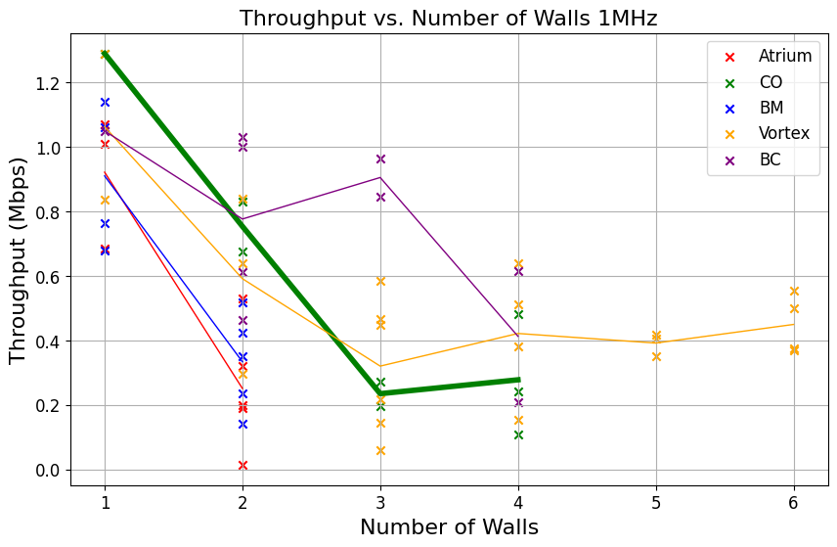
Indoor Results – Same Floor Results
CO
Evaluating the performance with a consistent change: 1 wall and 10m.
Max range: 40m, 4 concrete walls.
RSSI decreased significantly after the first wall, then decreased at smaller rates.
Throughput decreases almost consistently based on the RSSI and the corresponding MCS.
At border line condition an stable transmission of 250 kbps was performed
Overview
Regulations
Market Availability
Characterization Setup
Results & Interpretation
Summary
Notes:
Walls breaking capacity

Slide 29

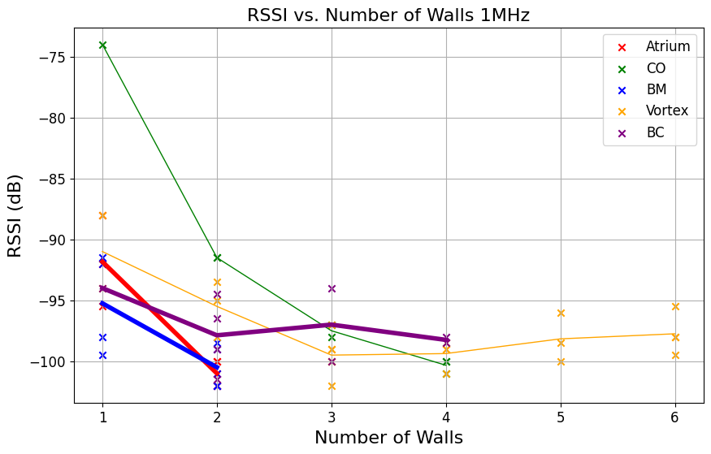
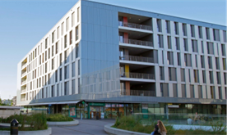
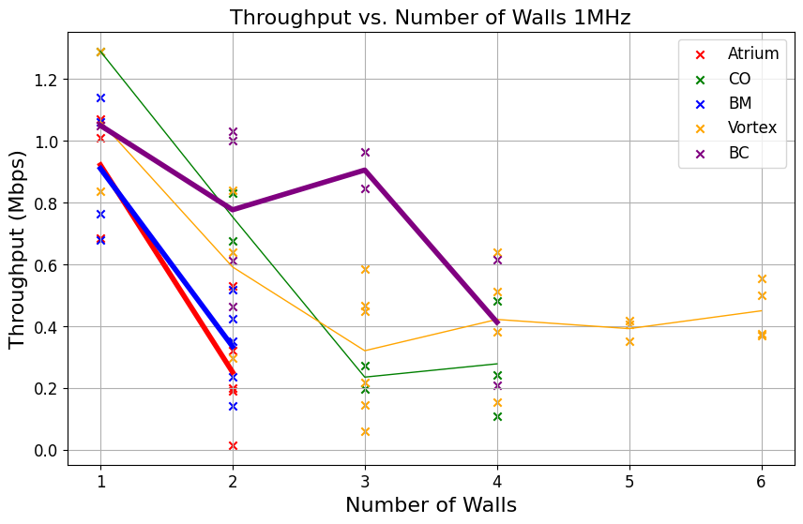
Indoor Results – Inter Floor Results
BM
Atrium
BC
We adjusted the antenna position while monitoring the RSSI to get the best possible signal.
Worse Signal propagation in comparison with the same floor scenario (CO).
Hard to go beyond 2 floors.
BC shows an open interior with thinner floors that could benefit reflections explaining the good results.
Overview
Regulations
Market Availability
Characterization Setup
Results & Interpretation
Summary
Notes:
Interpret Indoor intra floor measurements

Slide 30
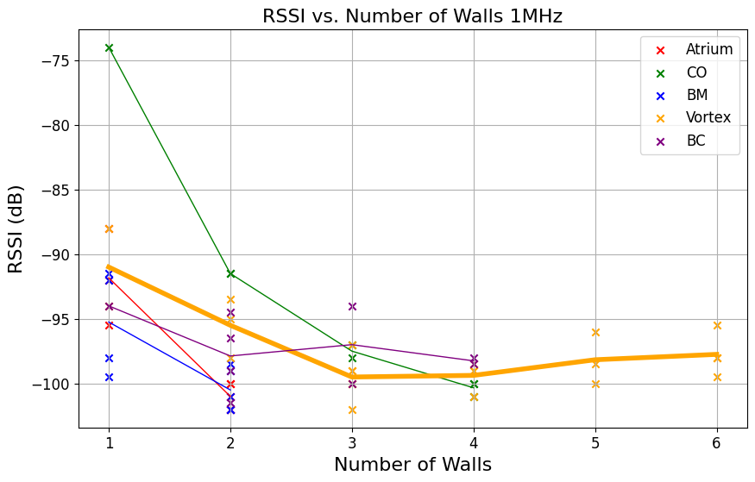

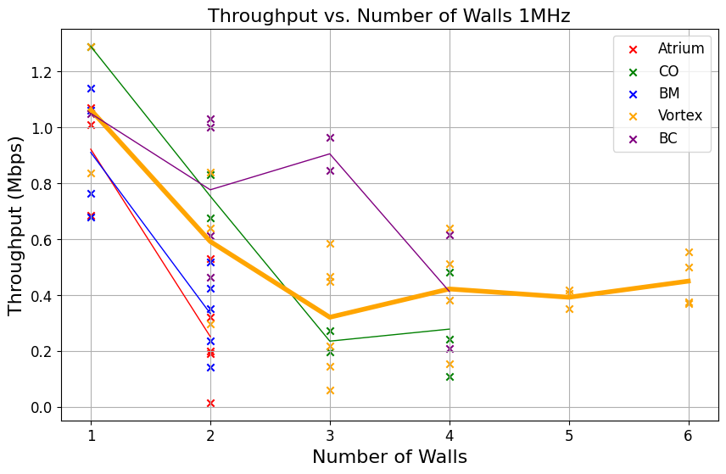
Indoor Results - Potential Outlier
Signal propagation possibly dominated by horizontal reflections
Overview
Regulations
Market Availability
Characterization Setup
Results & Interpretation
Summary
Notes:
Purpose: interpret Vortex values

Slide 31
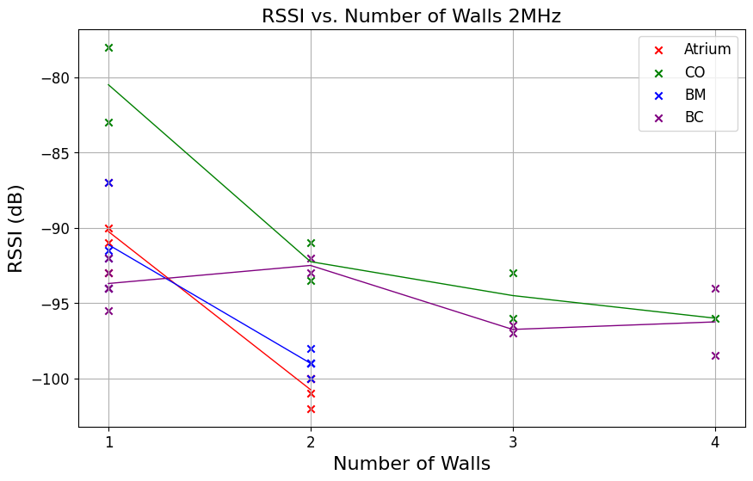
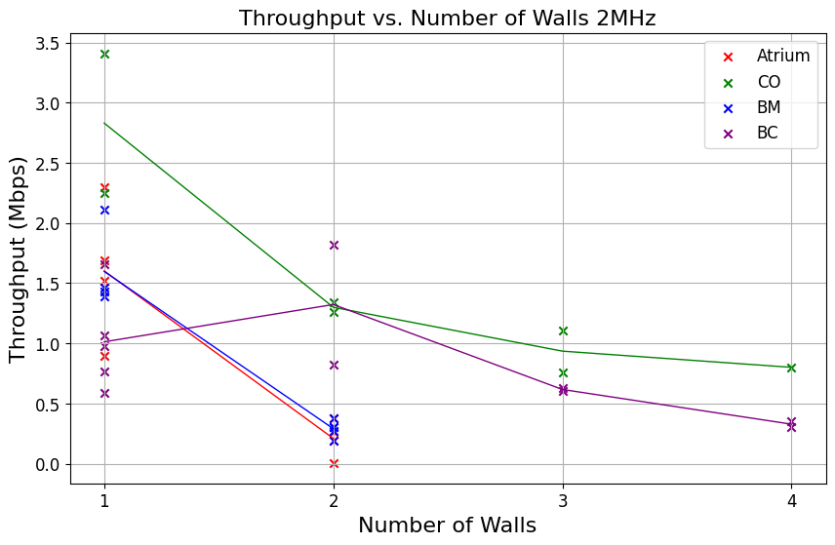
Indoor Results – 2MHz
2MHz channels has similar propagation than 1 MHz ones and offer almost 2x throughput
In every building, breached at least 2 walls/floors.
Signal degradation depends on building type.
Multipath fading could have affected measurement quality.
Overview
Regulations
Market Availability
Characterization Setup
Results & Interpretation
Summary

Slide 32
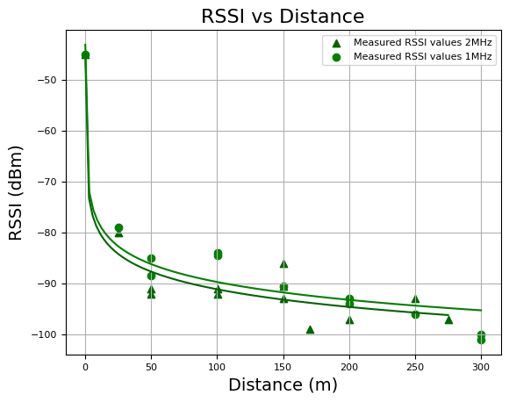
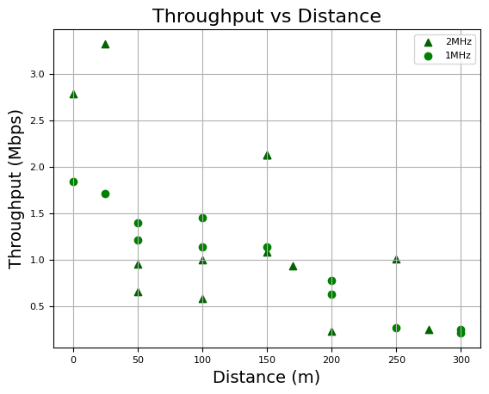
Outdoor Results
Max distance :
Stable connection: 300m
Unstable connection: 400 meters (RSSI = -103dB to low to perform any test).
Throughput at borderline condition: 250 kbps
Small differences in propagation between the two channel-widths.
Overview
Regulations
Market Availability
Characterization Setup
Results & Interpretation
Summary
Notes:
Purpose: show distance covered, per signal strength offer explanation why:could be interference

Slide 33
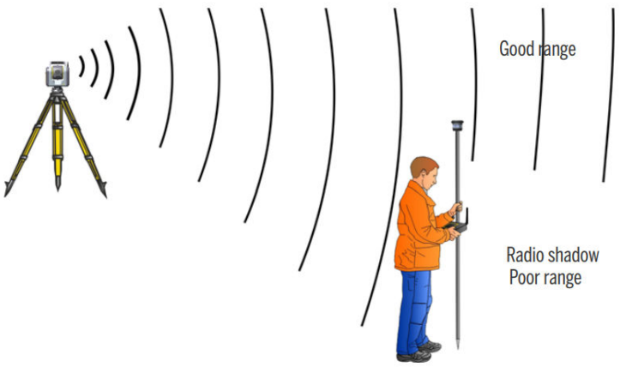
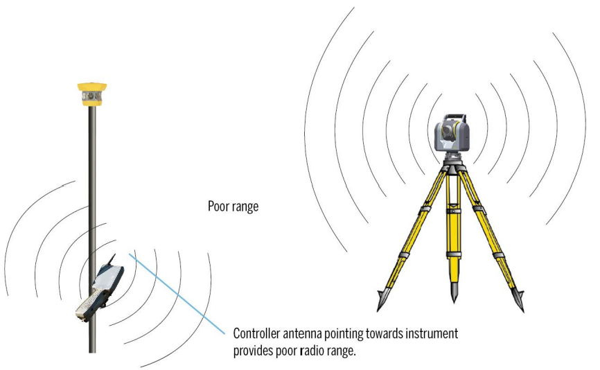
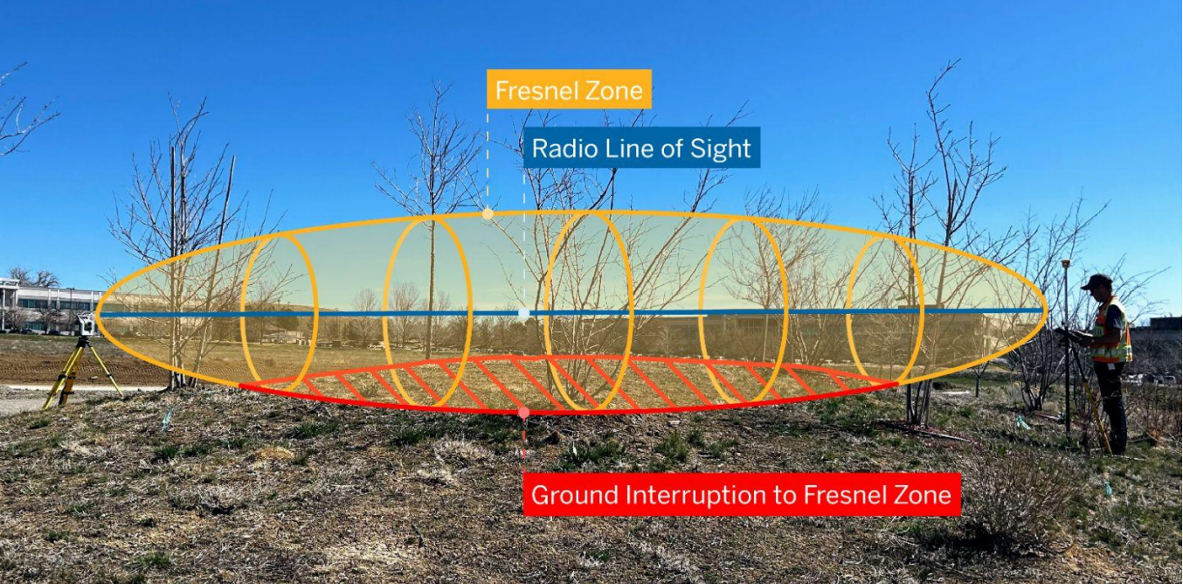
Outdoor Results – Potential Causes
Why didn’t we get any further ?
*Source: White Paper Wi-Fi HaLow Radio Technology with Trimble SX12 & EM130
Body Blocking Effect
Module Limitation?
Antenna Angle
Fresnel Zone
Overview
Regulations
Market Availability
Characterization Setup
Results & Interpretation
Summary
Notes:
Purpose: show distance covered, per signal strength offer explanation why:could be interference

Slide 34
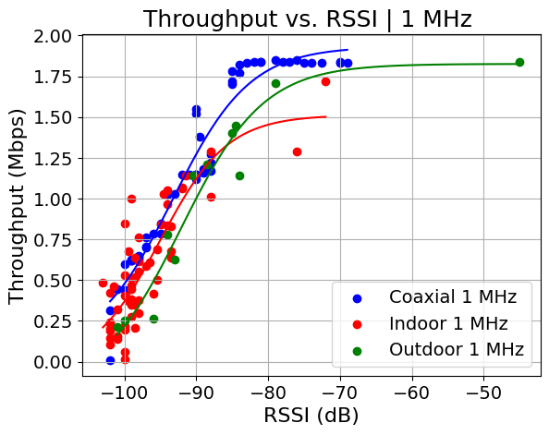
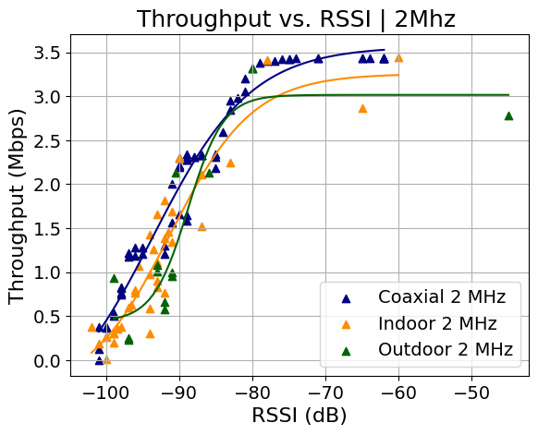
Comparing with Coaxial
Evaluating consistency across coaxial, indoor and outdoor measurements
Indoor and Outdoor results matches coaxial/controlled environment results.
Throughput vs RSSI trend remains consistent in all scenarios.
Higher RSSI needed for 2 MHz, tradeoff for higher throughput.
Overview
Regulations
Market Availability
Characterization Setup
Results & Interpretation
Summary
Notes:
Purpose: show that measurements align together with coaxial values + compare to theoretical maximum, give insight why are we off that value

Slide 35
OUTLINE
Overview
Regulations
Market Availability
Characterization Setup
Results & Interpretations
Summary

Slide 36
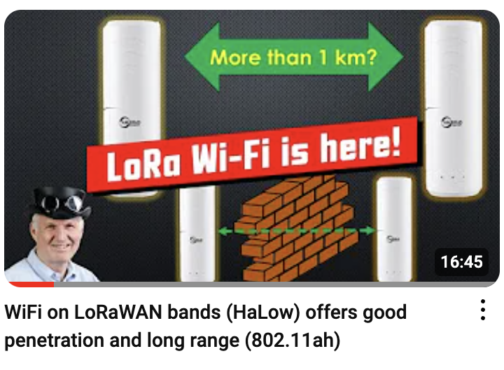
Summary
In compliance with the Swiss Regulations WiFi HaLow showed:
Robust Performance: In challenging scenarios, Wi-Fi HaLow demonstrated its ability to penetrate through tough obstacles, including at least two walls or floors in any building, reaching distances of tens of meters.
Stable Data Rates: Despite challenging conditions, Wi-Fi HaLow allowed connections from 250 kbps in borderline conditions, up to 3.5 Mbps in best case scenarios.
We believe reliable transmission in outdoor scenarios may still be achievable.
During our tests, we did not surpass 400 meters. This limitation may have been due to imprecise antenna positioning or interference in the measurement zone.
Andreas Speiss reached 1.4 km under conditions compliant with the regulations. Available at https://www.youtube.com/watch?v=rj9GZQtFs8k&t=863s
Overview
Regulations
Market Availability
Characterization Setup
Results & Interpretation
Summary

Slide 37
Wi-Fi HaLow 802.11ah characterization under Swiss / EU regulations
Francesco Murande
&
Tony Raffoul
Ecole Polytechnique Fédérale de Lausanne
5th June 2024

Slide 38
References
Wireless Broadband Alliance. Wi-Fi HaLow for IoT. Version 1.0.0. WBA Wi-Fi HaLow for IoT Project team. Jan. 2024. URL: https://wballiancec.wpenginepowered.com/wp-content/uploads/2024/01/WBA_Wi-Fi_HaLow_for_IoT_V-1.0.0.pdf
Le Tian, Serena Santi, Amina Seferagić, Julong Lan, Jeroen Famaey, Wi-Fi HaLow for the Internet of Things: An up-to-date survey on IEEE 802.11ah research, Journal of Network and Computer Applications, Volume 182,2021,103036, ISSN 1084-8045, https://doi.org/10.1016/j.jnca.2021.103036. URL: https://www.sciencedirect.com/science/article/pii/S108480452100062X)
Sébastien Maudet, Guillaume Andrieux, Romain Chevillon, Jean-François Diouris,Practical evaluation of Wi-Fi HaLow performance, Internet of Things, Volume 24, 2023, 100957, ISSN 2542-6605,URL: https://doi.org/10.1016/j.iot.2023.100957, URL: https://www.sciencedirect.com/science/article/pii/S2542660523002809
Federal Office of Communications OFCOM. "Licenses and Frequency Management / Frequency Planning." Zukunftstrasse 44, CH - 2501 Biel – Bienne, Switzerland. http://www.bakom.ch. https://www.bakom.admin.ch/bakom/en/homepage/frequencies-and-antennas/nationalfrequency-allocation-plan.html. © OFCOM Switzerland / Issue January 1st, 2022.
Federal Department of the Environment, Transport, Energy and Communication DETEC. Federal Office of Communications OFCOM. "Equipment and Frequency Management International, Radio Technology Section." March 2023. "WLAN Factsheet: Wireless Local Area Networks.”
Morse Micro. "Wi-Fi HaLow Power Consumption." Suite 113, 4 Cornwallis Street, National Innovation Centre, Eveleigh, NSW 2020, Australia
Richard Rudd et al. “Building Materials and Propagation: Final Report”. In: Ofcom 2604/BMEM/R/3/2.0 (Sept. 2014). Authors: Dr Richard Rudd (Aegis), Dr Ken Craig (Signal Science), Dr Martin Ganley (BRE), Richard Hartless (BRE). URL: https://www.qostic.org/Qostic/wpcontent/uploads/Qostic6/AHQ7805Building_Materials_and_Propagation.pdf
Saelens, M., Hoebeke, J., Shahid, A., & Poorter, E. D. (2019). Impact of EU duty cycle and transmission power limitations for sub-GHz LPWAN SRDs: An overview and future challenges. EURASIP Journal on Wireless Communications and Networking, 2019(1), 1-32. https://doi.org/10.1186/s13638-019-1502-5
ERC Recommendation 70-03, "Relating to the use of Short Range Devices (SRD)," Tromsø, 1997. Subsequent amendments: 12 February 2021. Please note the Implementation Status on page 44. URL: https://docdb.cept.org/download/25c41779-cd6e/Rec7003e.pdf
Martin, Troy. "Wi-Fi HaLow 802.11ah & Real-World Performance Results." Presented at WLPC Phoenix 2024. Uploaded by Wireless LAN Professionals. YouTube, 2024. Video,. https://www.youtube.com/watch?v=oFVj1RES9TU&t=611s.
Spiess, Andreas. "WiFi on LoRaWAN bands (HaLow) offers good penetration and long range (802.11ah)." YouTube, uploaded by Andreas Spiess, May 2024 ,Video, 16:44. URL: https://www.youtube.com/watch?v=rj9GZQtFs8k&t=679s.$
IEEE. "IEEE Std 802.11ah™-2016 (Amendment to IEEE Std 802.11™-2016 as amended by IEEE Std 802.11ai™-2016).“
Partou, Mehdi.White Paper Wi-Fi HaLow Radio Technology withTrimble SX12 & EM130
Soares, S.M.; Carvalho, M.M. "Throughput Analytical Modeling of IEEE 802.11ah Wireless Networks." Proceedings of the 2019 16th IEEE Annual Consumer Communications & Networking Conference (CCNC), Las Vegas, NV, USA, 8–11 January 2019, p. 18492924.
Kane, Luke et al. “An Experimental Field Comparison of Wi-Fi HaLow and LoRa for the Smart Grid” URL: https://www.researchgate.net/publication/373415591_An_Experimental_Field_Comparison_of_Wi-Fi_HaLow_and_LoRa_for_the_Smart_Grid
Overview
Regulations
Market Availability
Characterization Setup
Results & Interpretation
Summary

